Slide 1
Queues
  1. FIFO data structure
  2. Array Implementation
  3. Linked List Implementation
  5. Exercise // enqueue/dequeue
  6. Problem // queue to stack
  7. Queue Applications
  8. Queue Operations
  9. Queue ADT

Slide 2
First In First Out data structure.
Restricted linear list:
Insert – restricted → insert at the end // enqueue
Delete – restricted → delete from the beginning // dequeue

Slide 3
First In First Out data structure.
Restricted linear list:
Insert – restricted → insert at the end // enqueue
Delete – restricted → delete from the beginning // dequeue

Slide 4
front
rear
First In First Out data structure.
Restricted linear list:
Insert – restricted → insert at the end // enqueue
Delete – restricted → delete from the beginning // dequeue

Slide 5
front
rear
First In First Out data structure.
Restricted linear list:
Insert – restricted → insert at the end // enqueue
Delete – restricted → delete from the beginning // dequeue

Slide 6
front
rear
First In First Out data structure.
Restricted linear list:
Insert – restricted → insert at the end // enqueue
Delete – restricted → delete from the beginning // dequeue

Slide 7
front
rear
First In First Out data structure.
Restricted linear list:
Insert – restricted → insert at the end // enqueue
Delete – restricted → delete from the beginning // dequeue

Slide 8
front
rear
First In First Out data structure.
Restricted linear list:
Insert – restricted → insert at the end // enqueue
Delete – restricted → delete from the beginning // dequeue

Slide 9
front
rear
First In First Out data structure.
Restricted linear list:
Insert – restricted → insert at the end // enqueue
Delete – restricted → delete from the beginning // dequeue

Slide 10
front
rear
First In First Out data structure.
Restricted linear list:
Insert – restricted → insert at the end // enqueue
Delete – restricted → delete from the beginning // dequeue

Slide 11
front
rear
First In First Out data structure.
Restricted linear list:
Insert – restricted → insert at the end // enqueue
Delete – restricted → delete from the beginning // dequeue

Slide 12
Array / Vector
Queue Implementations
  Linked List

Slide 13
queue
10
20
30
0
1
2
3
4
5
6
7
8
9
Array Implementation of Queue

Slide 14
queue
10
20
30
0
1
2
3
4
5
6
7
8
9
front
rear
Array Implementation of Queue

Slide 15
queue
10
20
30
0
1
2
3
4
5
6
7
8
9
front
rear
Enqueue 40
Array Implementation of Queue

Slide 16
queue
10
20
30
40
0
1
2
3
4
5
6
7
8
9
front
rear
Array Implementation of Queue

Slide 17
queue
10
20
30
40
0
1
2
3
4
5
6
7
8
9
front
rear
Enqueue 25
Array Implementation of Queue

Slide 18
queue
10
20
30
40
0
1
2
3
4
5
6
7
8
9
front
rear
rear = rear + 1
Enqueue 25
Array Implementation of Queue

Slide 19
queue
10
20
30
40
0
1
2
3
4
5
6
7
8
9
front
rear
rear = rear + 1
Enqueue 25
Array Implementation of Queue

Slide 20
queue
10
20
30
40
25
0
1
2
3
4
5
6
7
8
9
front
rear
rear = rear + 1
queue[rear] = dataIn
Enqueue 25
Array Implementation of Queue

Slide 21
queue
10
20
30
40
25
0
1
2
3
4
5
6
7
8
9
front
rear
if ( queue not full )
rear = rear + 1
queue[rear] = dataIn
else
queue is in OVERFLOW state
Array Implementation of Queue

Slide 22
queue
10
20
30
40
25
0
1
2
3
4
5
6
7
8
9
front
rear
Dequeue
Array Implementation of Queue

Slide 23
queue
20
30
40
25
0
1
2
3
4
5
6
7
8
9
front
rear
Array Implementation of Queue

Slide 24
queue
20
30
40
25
0
1
2
3
4
5
6
7
8
9
front
rear
if ( queue not empty )
dataOut = queue[front]
front = front + 1
else
queue is in UNDERFLOW state
Dequeue
Array Implementation of Queue

Slide 25
queue
30
40
25
0
1
2
3
4
5
6
7
8
9
front
rear
Array Implementation of Queue

Slide 26
queue
60
75
25
10
70
30
50
80
0
1
2
3
4
5
6
7
8
9
rear
front
Array Implementation of Queue

Slide 27
Array / Vector
Queue Implementations
  Linked List

Slide 28
front
rear
create – create a queue object // constructor
enqueue – insert a new item (rear)
dequeue – delete the item (front)
getFront – pass back the value of the first element without removing it
getRear – pass back the value of the last element without removing it
getCount – returns the number of nodes
isEmpty – checks if the queue is empty
destroy – deletes all nodes // destructor
First In First Out data structure.
Restricted linear list:
Insert – restricted → insert at the end // enqueue
Delete – restricted → delete from the beginning // dequeue
Queue Operations

Slide 29
queue
- front - rear - count
// constructor // destructor + enqueue + dequeue + getFront + getRear + getCount + isEmpty

Slide 30
front
count
rear
3
queue
9
7
5
algorithm dequeue( item )
Delete one item from a queue
Pre:
Post: Data at the front of the queue returned to user through item and front
element recycled.
Return: true if successful, false if empty queue
. . .
end dequeue
DEQUEUE

Slide 31
front
count
rear
0
queue
if( count is 0 )
return false
DEQUEUE

Slide 32
front
count
rear
3
queue
9
7
5
deleteLoc
if( count is 0 )
return false
item = front->data
deleteLoc = front
DEQUEUE

Slide 33
front
count
rear
1
queue
5
deleteLoc
if( count is 0 )
return false
item = front->data
deleteLoc = front
if( count is 1 )
rear = NULL
DEQUEUE

Slide 34
front
count
rear
1
queue
5
deleteLoc
if( count is 0 )
return false
item = front->data
deleteLoc = front
if( count is 1 )
rear = NULL
front = front->next
DEQUEUE

Slide 35
front
count
rear
0
queue
5
deleteLoc
if( count is 0 )
return false
item = front->data
deleteLoc = front
if( count is 1 )
rear = NULL
front = front->next
count--
DEQUEUE

Slide 36
front
count
rear
0
queue
if( count is 0 )
return false
item = front->data
deleteLoc = front
if( count is 1 )
rear = NULL
front = front->next
count--
recycle( deleteLoc )
DEQUEUE

Slide 37
front
count
rear
0
queue
if( count is 0 )
return false
item = front->data
deleteLoc = front
if( count is 1 )
rear = NULL
front = front->next
count--
recycle( deleteLoc )
return true
DEQUEUE

Slide 38
front
count
rear
3
queue
9
7
5
deleteLoc
if( count is 0 )
return false
item = front->data
deleteLoc = front
if( count is 1 )
rear = NULL
front = front->next
DEQUEUE

Slide 39
front
count
rear
2
queue
9
7
5
deleteLoc
if( count is 0 )
return false
item = front->data
deleteLoc = front
if( count is 1 )
rear = NULL
front = front->next
count--
DEQUEUE

Slide 40
front
count
rear
2
queue
7
5
if( count is 0 )
return true
item = front->data
deleteLoc = front
if( count is 1 )
rear = NULL
front = front->next
count--
recycle( deleteLoc )
return true
DEQUEUE

Slide 41
Exercise: What would be the contents of q and s after the following code is executed?
q.enqueue(10)
q.enqueue(90)
q.enqueue(50)
q.enqueue( 0)
q.enqueue(40)
q.enqueue(20)
q.enqueue( 0)
q.enqueue(60)
q.enqueue(10)
q.enqueue(20)
q.enqueue( 0)
sum = 0
c = q.getCount()
loop (c != 0)
q.dequeue(x)
if (x != 0)
q.enqueue(x)
sum += x
else
s.push(sum)
sum = 0
end if
c = c - 1
end loop

Slide 42
q:
10
90
50
0
40
20
0
60
10
25
0
front
rear
q.enqueue(10)
q.enqueue(90)
q.enqueue(50)
q.enqueue( 0)
q.enqueue(40)
q.enqueue(20)
q.enqueue( 0)
q.enqueue(60)
q.enqueue(10)
q.enqueue(20)
q.enqueue( 0)

Slide 43
q:
10
90
50
0
40
20
0
60
10
25
0
front
rear
sum = 0
c = q.getCount()
loop (c != 0)
q.dequeue(x)
if (x != 0)
q.enqueue(x)
sum += x
else
s.push(sum)
sum = 0
end if
c = c - 1
end loop
s:

Slide 44
q:
10
90
50
40
20
60
10
25
front
rear
sum = 0
c = q.getCount()
loop (c != 0)
q.dequeue(x)
if (x != 0)
q.enqueue(x)
sum += x
else
s.push(sum)
sum = 0
end if
c = c - 1
end loop
95
s:
60
150

Slide 45
Problem: create a stack from a queue
10
20
30
10
q
// before
20
30
s
q
// after

Slide 46
10
20
30
q
s
temp

Slide 47
20
30
q
loop( !q.isEmpty() )
q.dequeue(item)
temp.push(item)
end loop
s
10
temp

Slide 48
30
q
loop( !q.isEmpty() )
q.dequeue(item)
temp.push(item)
end loop
20
s
10
temp

Slide 49
q
loop( !q.isEmpty() )
q.dequeue(item)
temp.push(item)
end loop
30
20
s
10
temp

Slide 50
q
loop( !q.isEmpty() )
q.dequeue(item)
temp.push(item)
end loop
loop( !temp.isEmpty() )
temp.pop(item)
s.push(item)
end loop
30
20
s
10
temp

Slide 51
q
20
loop( !q.isEmpty() )
q.dequeue(item)
temp.push(item)
end loop
loop( !temp.isEmpty() )
temp.pop(item)
s.push(item)
end loop
30
s
10
temp

Slide 52
10
q
20
loop( !q.isEmpty() )
q.dequeue(item)
temp.push(item)
end loop
loop( !temp.isEmpty() )
temp.pop(item)
s.push(item)
end loop
30
s
temp

Slide 53
10
q
20
loop( !q.isEmpty() )
q.dequeue(item)
temp.push(item)
end loop
loop( !temp.isEmpty() )
temp.pop(item)
s.push(item)
end loop
30
s

Slide 54
algorithm queueToStack( queue )
This algorithm creates a stack from a queue; the front of the queue is to be
the top of the stack; after creating the stack the queue is to be empty.
Pre: queue – contains data
Post: queue – empty
Return: stack
  loop( !q.isEmpty() )
  q.dequeue(item)
  temp.push(item)
  end loop
  loop( !temp.isEmpty() )
  temp.pop(item)
  s.push(item)
  end loop
return stack
end queueToStack

Slide 55
Queues
  1. FIFO data structure
  2. Array Implementation
  3. Linked List Implementation
  5. Exercise // enqueue/dequeue
  6. Problem // queue to stack
  7. Queue Applications
  8. Queue Operations
  9. Queue ADT

Slide 56
Typical queue applications:
Categorizing data.

Slide 57
Typical queue applications:
Categorizing data ( for instance put positive numbers in one category, negative numbers in another category, discard 0s, and preserve the original order)
10 90 -50 0 -40 -20 0 60 -10 0
qPos:
10
90
60
front
rear
qNeg:
-50
-40
-20
-10
front
rear

Slide 58
Typical queue applications:
Categorizing data // preserve the order
Operating systems often maintain a queue of processes that are ready to execute or that are waiting for a particular event to occur.

Slide 59
Typical queue applications:
Categorizing data.
Operating systems often maintain a queue of processes that are ready to execute or that are waiting for a particular event to occur.
Computer systems must often provide a “holding area” for messages between two processes, two programs, or even two systems. This holding area is usually called a “buffer” and is often implemented as a queue.

Slide 60
Typical queue applications:
Categorizing data.
Operating systems often maintain a queue of processes that are ready to execute or that are waiting for a particular event to occur.
Computer systems must often provide a “holding area” for messages between two processes, two programs, or even two systems. This holding area is usually called a “buffer” and is often implemented as a queue.
Queue simulation

Slide 61
Application: Simulation
Simulation: technique for modeling behavior of natural and human-made systems.
Problem to simulate: model bank queue wait times
  Average time customer waits to begin service from current single teller
  Decrease in customer wait time with each new teller added
Data Structures and Problem Solving with C++: Walls and Mirrors, Carrano and Henry, © 2013

Slide 62
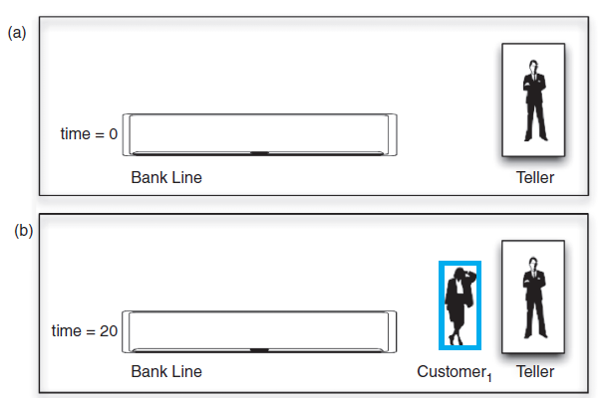
Application: Simulation
FIGURE 13-6 A bank line at time (a) 0; (b) 20;
Data Structures and Problem Solving with C++: Walls and Mirrors, Carrano and Henry, © 2013

Slide 63
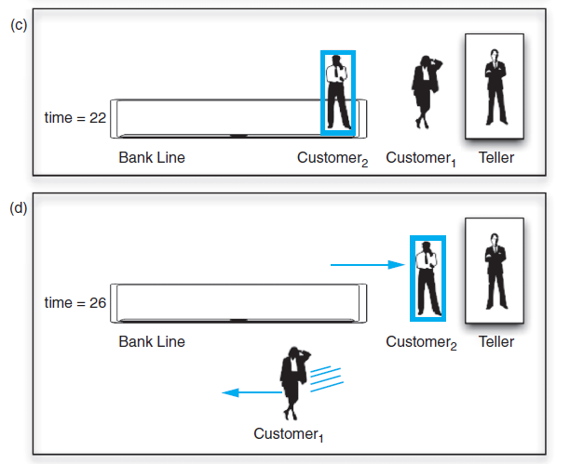
Application: Simulation
FIGURE 13-6 A bank line at time (c) 22; (d) 26
Data Structures and Problem Solving with C++: Walls and Mirrors, Carrano and Henry, © 2013

Slide 64
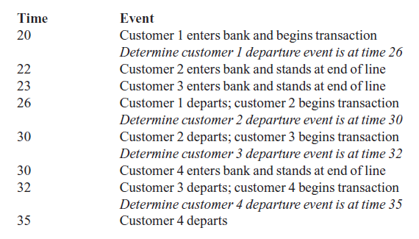
Application: Simulation
Results of a simulation:
Data Structures and Problem Solving with C++: Walls and Mirrors, Carrano and Henry, © 2013

Slide 65
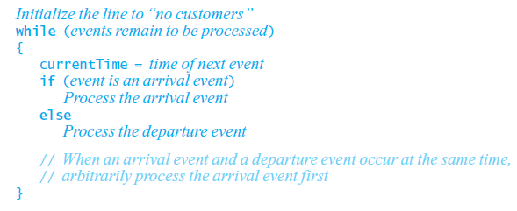
Application: Simulation
An event-driven simulation considers only times of certain events
  In this case, arrivals and departures
Algorithm
Data Structures and Problem Solving with C++: Walls and Mirrors, Carrano and Henry, © 2013

Slide 66
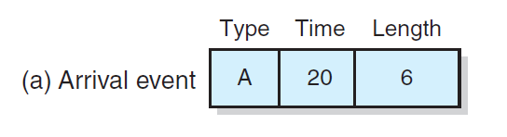
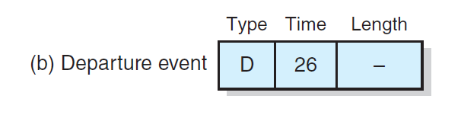
Application: Simulation
FIGURE 13-7 A typical instance of (a) an arrival event; (b) a departure event
Data Structures and Problem Solving with C++: Walls and Mirrors, Carrano and Henry, © 2013

Slide 67
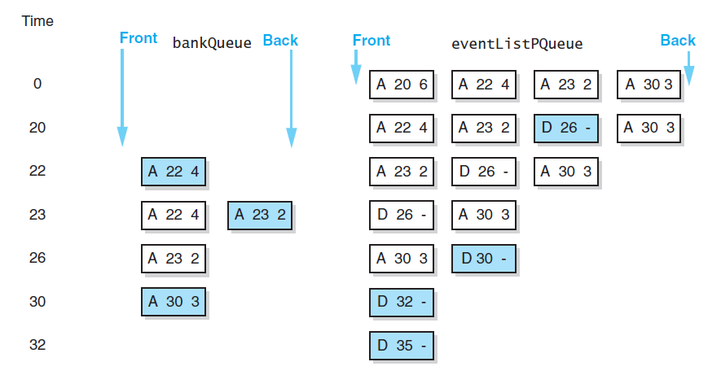
Application: Simulation
FIGURE 13-8 A trace of the bank
simulation algorithm for the data
Data Structures and Problem Solving with C++: Walls and Mirrors, Carrano and Henry, © 2013

Slide 68
Queues
  1. FIFO data structure
  2. Array Implementation
  3. Linked List Implementation
  5. Exercise // enqueue/dequeue
  6. Problem // queue to stack
  7. Queue Applications
  8. Queue Operations
  9. Queue ADT

Slide 69
front
rear
create – create a queue object // constructor
enqueue – insert a new item (rear)
dequeue – delete the item (front)
getFront – pass back the value of the first element without removing it
getRear – pass back the value of the last element without removing it
getCount – returns the number of nodes
isEmpty – checks if the queue is empty
destroy – deletes all nodes // destructor
First In First Out data structure.
Restricted linear list:
Insert – restricted → insert at the end // enqueue
Delete – restricted → delete from the beginning // dequeue
Queue Operations

Slide 70
Queues
  1. FIFO data structure
  2. Array Implementation
  3. Linked List Implementation
  5. Exercise // enqueue/dequeue
  6. Problem // queue to stack
  7. Queue Applications
  8. Queue Operations
  9. Queue ADT

